Slide 1

Building a test system based on PXI Matrix Switch modules

Slide 2
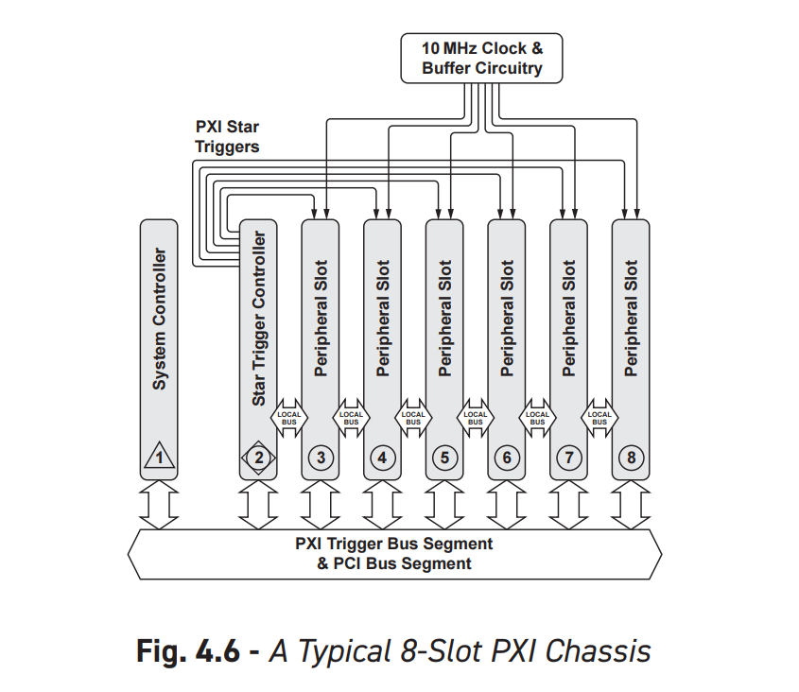
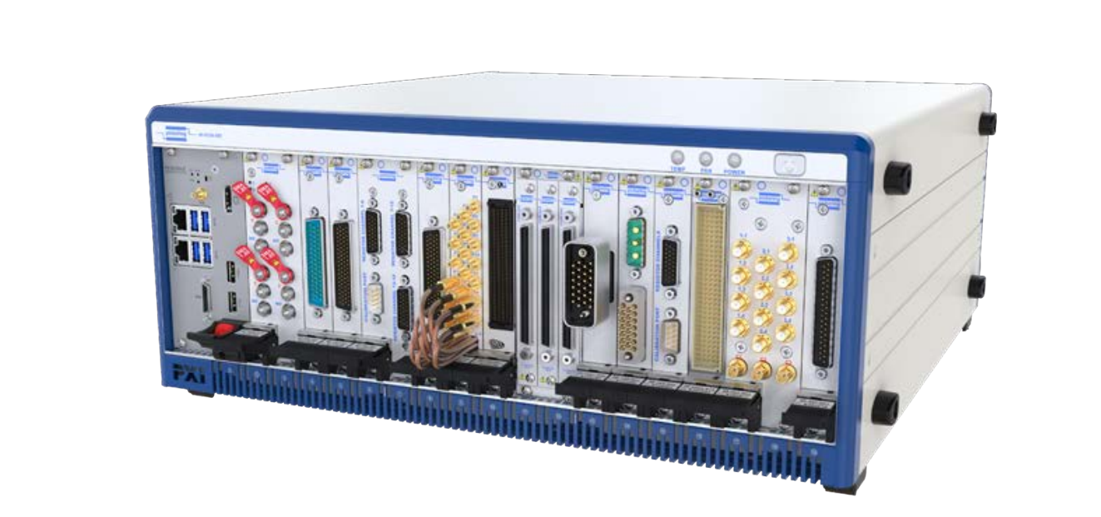
PXI Overview: Chassis
Chassis
Special slot for controller
Special slot for start trigger (optional)
Peripheral slots
Power
Cooling
Isolated ground

Slide 3
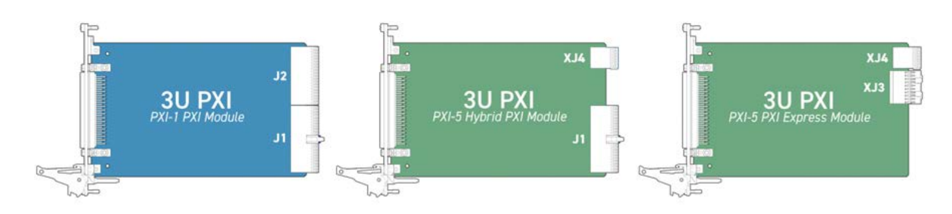
PXI Overview: Slot types
Module may take up multiple slots
Slot sizes (slot height)
3U (most common)
6U
PXI was based on PCI
PXIe is based on PCIe
PXI-H hybrid slot supports both PXIe and PXI

Slide 4
Minimum requirements to build a test
Voltage measurement
Resistance measurement
Arbitrary voltage source
Current measurement (rare)
Being able to construct arbitrary circuits

Slide 5
Minimum requirements to build a test
Voltage measurement
Resistance measurement
Arbitrary voltage source
Current measurement (rare)
Being able to construct arbitrary circuits

Slide 6
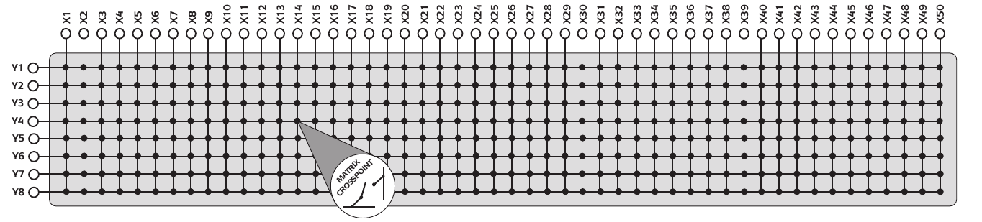
How to perform routing using a matrix?
Each matrix has a long X dimension and a shorter Y dimension
You may try to place test resources such as DMM and voltage sources on a short axis
You will find this has shortcomings!
Instead, just place all nodes on X axis
Much simpler and it will work…
X
Y
Notes:
How do you use a matrix to build tests? When you look at different modules, the first thing you notice they have one short and one long dimension. You may try to put your scarce resources such as DMM probes or voltage sources on the short dimension and then put the device under test pins on the long dimension. This would work to a point, but soon you will realize you may want to duplicate some test resources onto the long axis to be able to build more types of circuits. Ultimately you can duplicate all your resources and have an 8x8 square dedicated to test resource pins. This has one problem though: the number of test resources must be less than the Y dimension of the matrix. Additionally, if you have more Y rows than the test resources you don’t have a way of using the extra rows, they are just dead wait.

Slide 7
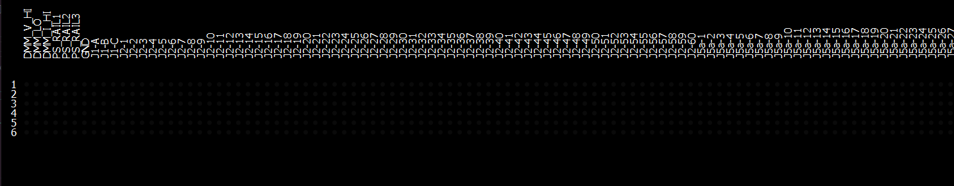
How to perform routing using a matrix?
The long axis is assigned to both Device Under Test (DUT) and test resource nodes.
Do not place anything on Y axis…
… until it is time to route!
X
Y

Slide 8
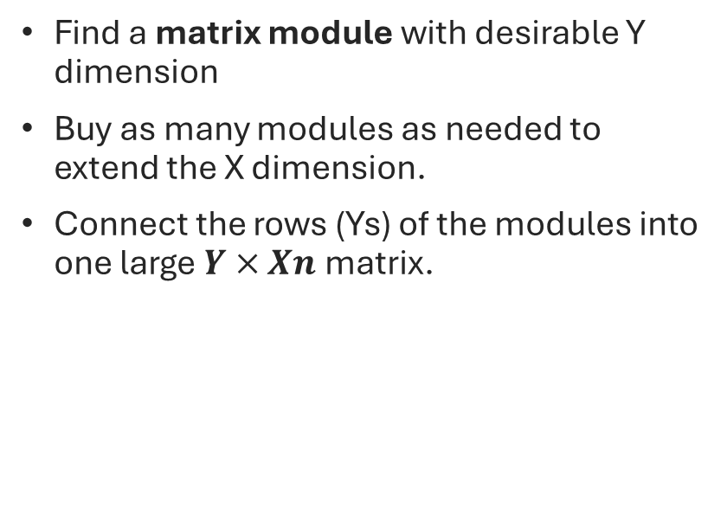
Extending a matrix
Find a matrix module with desirable Y dimension
Buy as many modules as needed to extend the X dimension.
Connect the rows (Ys) of the modules into one large $Y×Xn$ matrix.
Notes:
This matrix is ending up very long. Where do you get a matrix with over 200 columns? You get one by connecting rows of smaller matrices.

Slide 9
How to perform routing using a matrix?
Use Y-axis rows to make arbitrary connections between X-axis columns
Each net requires a single row
Notes:
The best way to route using a matrix is to keep track of nets. Each net requires a single row to implement it. For each net, select a row. Go over each node in the net and find the intersection of its column with the row. Turn the relay at intersection on to connect it. Each row acts as a set and by connecting columns to it you add it to the set.

Slide 10
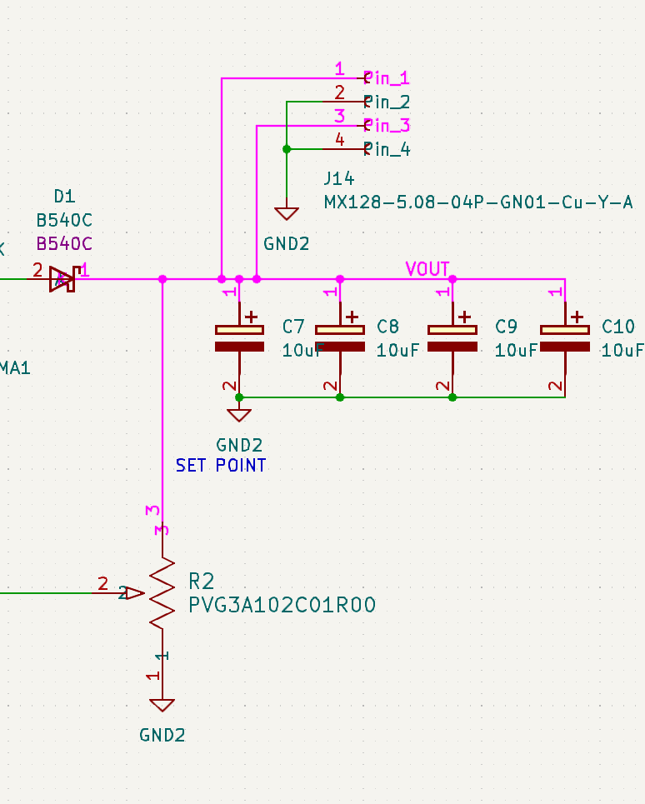


Aside Q: What is a net? A: A net is a description of connectivity.
Formally, a net is a set of connected nodes.
Circuit may contain multiple nets.
Nets are disjoint sets, meaning a node can only belong to one net.

Slide 11
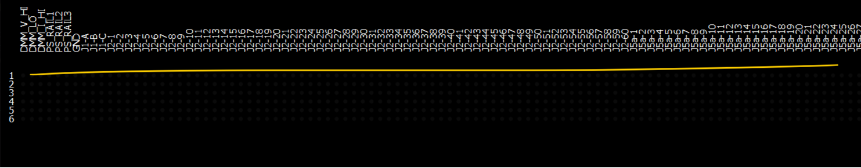
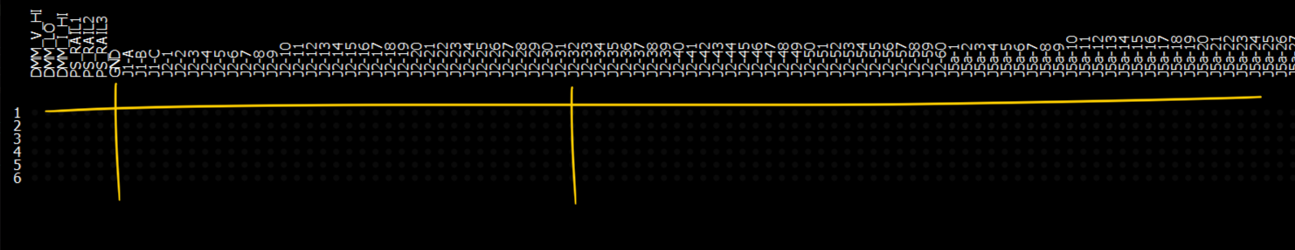
Example: Connect J2-32 to GND
Pick an unused row
Intersect J2-32 column with the row
Turn the relay at intersection on

Slide 12
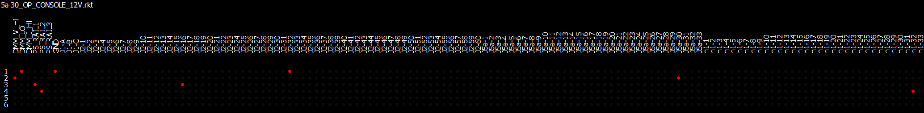
How big does the matrix need to be?
Tiger control box requires 204 targets
In addition to 7 tester targets
For a total of 211 targets on X-axis
Y-axis requirements depend on number of simultaneous nets in a test
Maximum Y-axis usage was 4 in simulations
A Y-axis of 6 would be preferred.

Slide 13
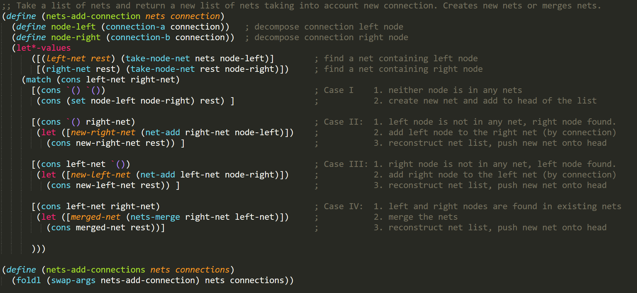
Build your own matrix router in two LISP calls:
Routing matrix was implemented in LISP in two functions
First one builds nets from connections

Slide 14
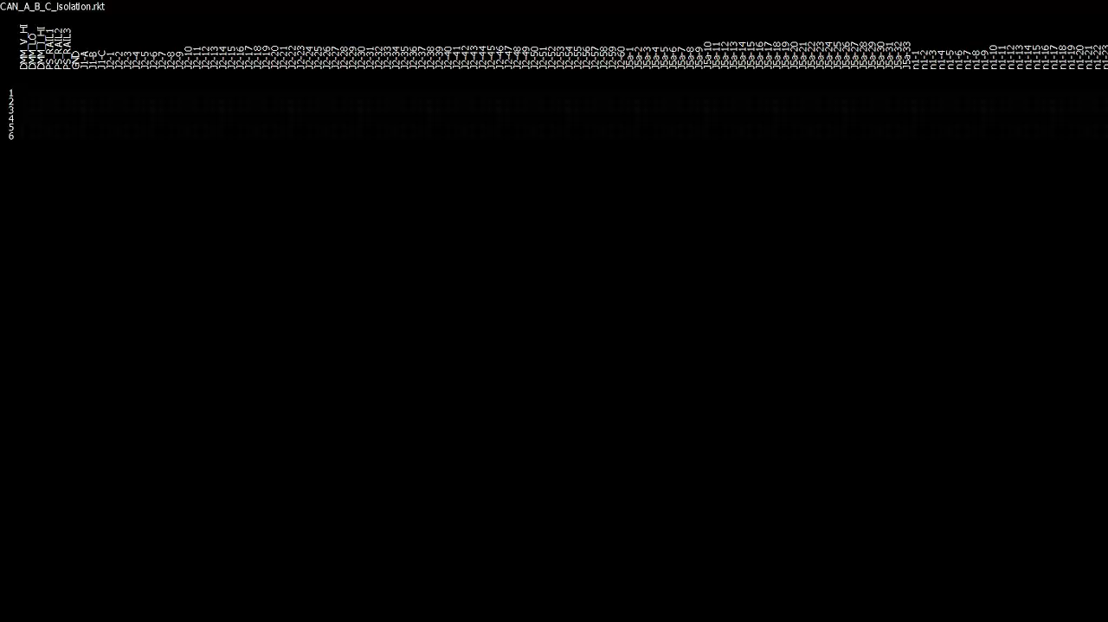
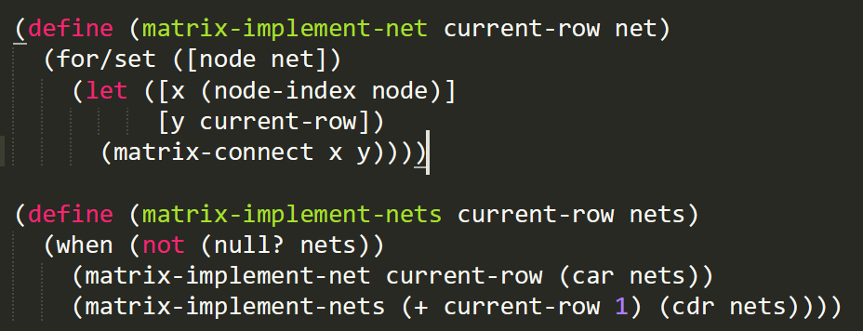
Build your own matrix router in two LISP calls:
Second one, flips the relays on…

Slide 15

Test resource nodes
The 7 test targets are dedicated to test resources
DMM_V_HI is Voltage Probe +
DMM_LO is DMM Ground
DMM_I_HI is DMM Current Probe +
PS_RAIL1,2,3 are adjustable power supply controlled by the test
GND

Slide 16
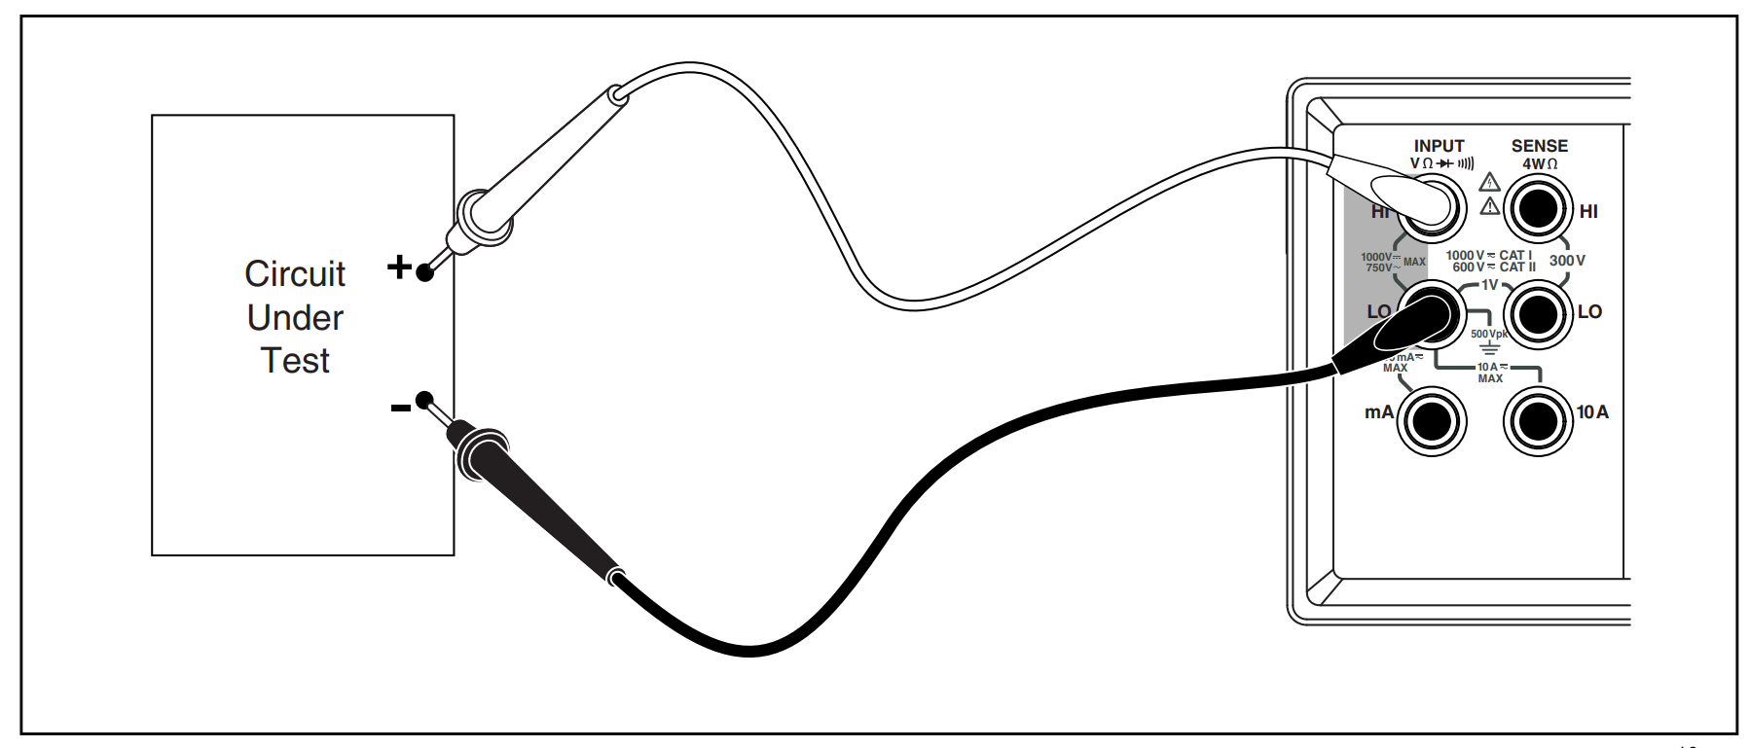
Test resource nodes
DMM_V_HI
DMM_LO
DMM_I_HI

Slide 17
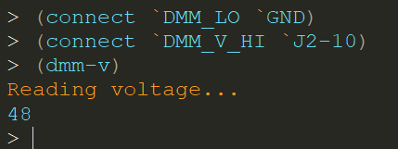
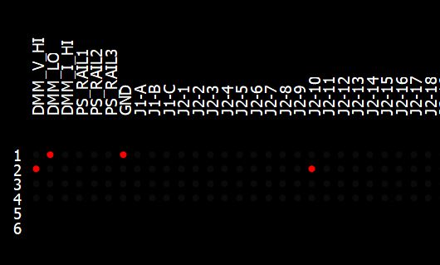
Making a basic voltage measurement
Note on LISP syntax:
Calling a function
(<function name> arg1 arg2 …)
Symbol syntax
`<symbol> also ‘<symbol>
COST: 2 ROWS

Slide 18
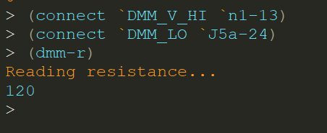
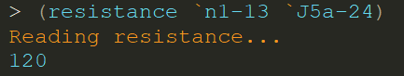
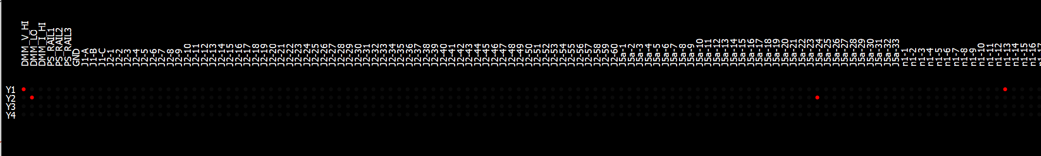
Making a basic resistance measurement
COST: 2 ROWS

Slide 19
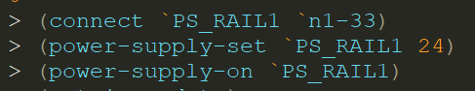
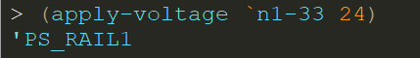
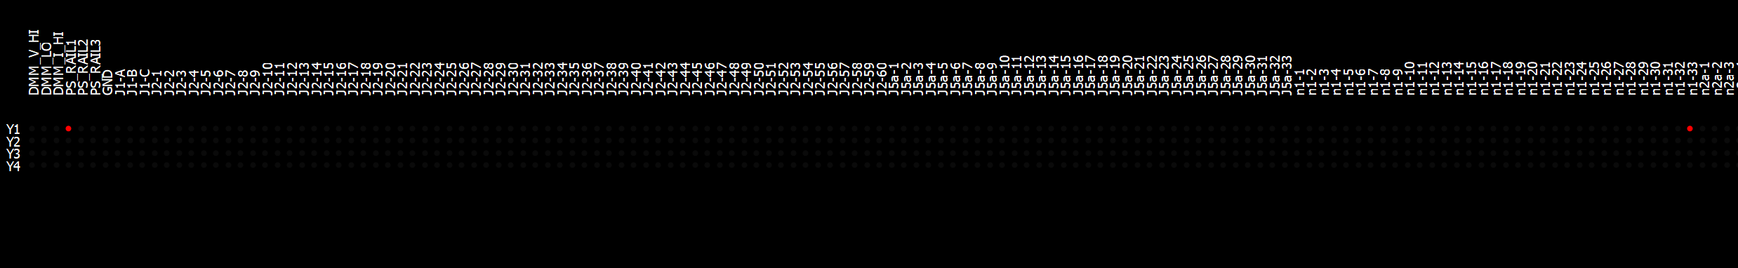
Applying a voltage signal
COST: 1 ROW

Slide 20
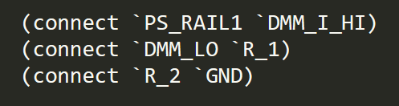
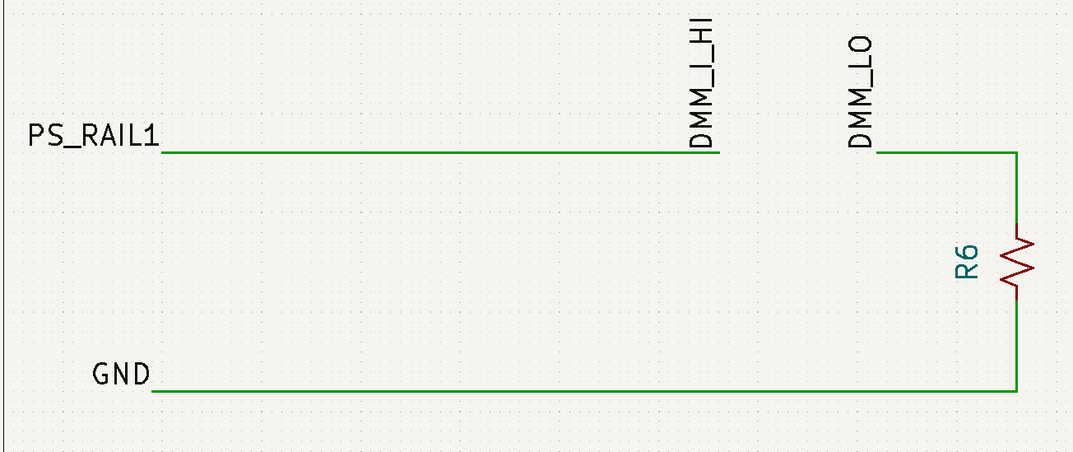
Performing a current measurement (not used for Tiger)
COST: 3 ROWS

Slide 21
Test language
connect two nodes a and b together
measure voltage between a and b nodes
measure resistance from a to b
apply-voltage v to node a
Connectivity | Power | Measurement
(connect a b) | (power-supply-set rail v) | (dmm-v)
(disconnect a b) | (power-supply-on rail) | (dmm-i)
(disconnect-all) | (power-supply-off rail) | (dmm-r)
 | (apply-voltage a v) | (voltage a b)
 | (remove-voltage a) | (resistance a b)
 | (apply-ground a)

Slide 22
Test language
connect two nodes a and b together
Take dmm-voltage reading depending on where DMM_V_HI and DMM_V_LO are connected
Take dmm-resistance reading depending on where DMM_V_HI and DMM_V_LO are connected
Manually control power-supply nodes with …-set, on, off
Connectivity | Power | Measurement
(connect a b) | (power-supply-set rail v) | (dmm-v)
(disconnect a b) | (power-supply-on rail) | (dmm-i)
(disconnect-all) | (power-supply-off rail) | (dmm-r)
 | (apply-voltage a v) | (voltage a b)
 | (remove-voltage a) | (resistance a b)
 | (apply-ground a)

Slide 23
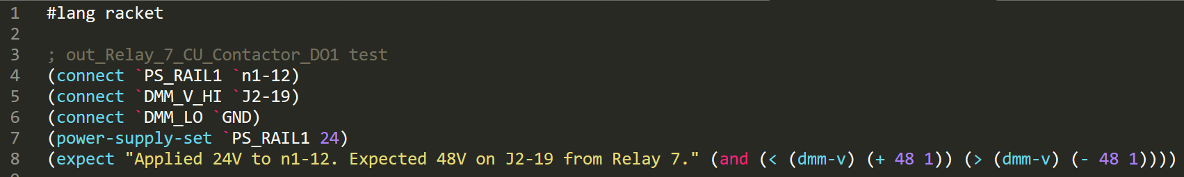
Expect is way of asserting correct behavior
expect takes a message and Boolean expression
expect fails the test when the Boolean expression is false and returns an error message to the test system.

Slide 24
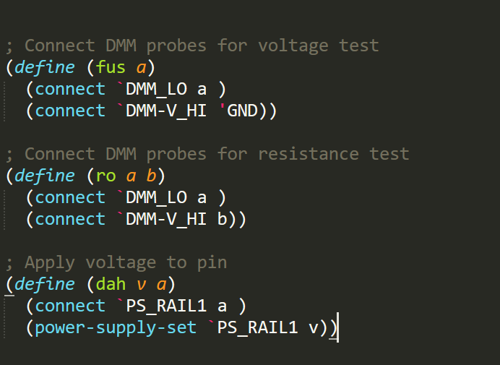
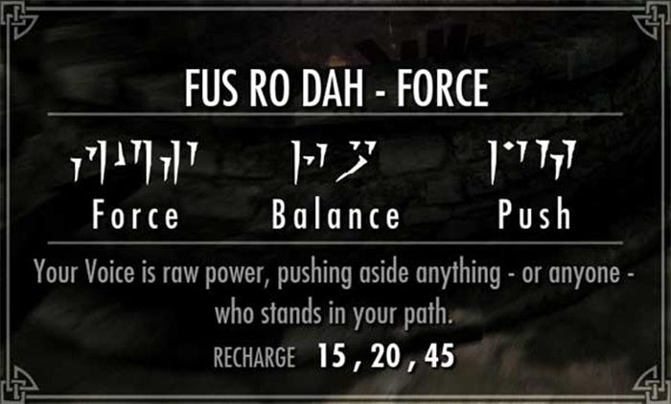
Simplifying common patterns
We can define more shorthand calls to simplify common patterns

Slide 25
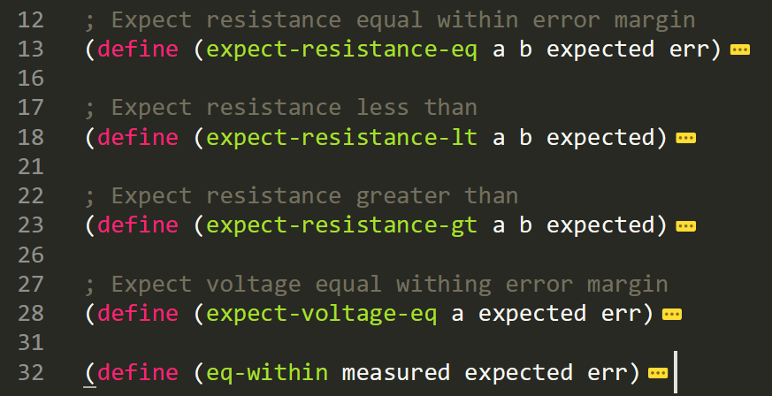
Simplifying common patterns
We can define more shorthand calls to simplify common patterns

Slide 26
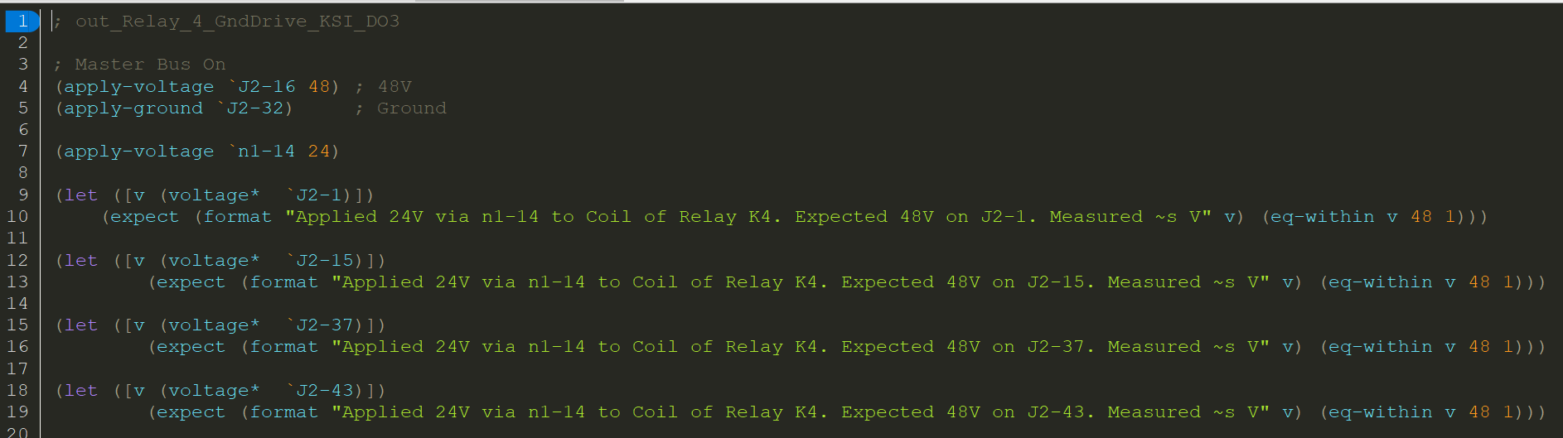
Real test examples: KSI Relay
Applies 48V and GROUND to turn control box “on”.
Applies voltage to coil of relay K4
Reads voltages at various relay outputs
“Expect” is an assertion about “truthness” of a Boolean value
Test fails when expression return false

Slide 27
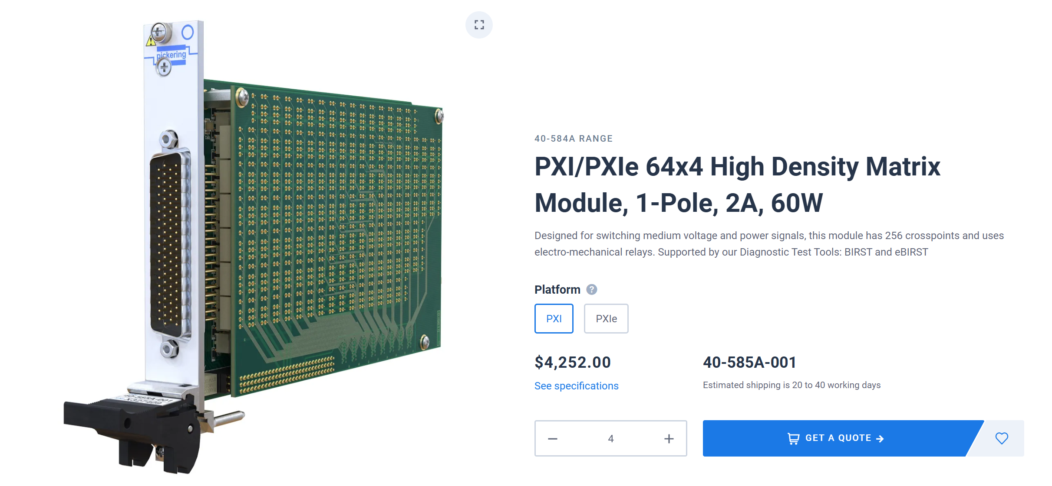
4x64 Matrix Option from Pickering
Having 4 rows in Y-axis is very limiting
Need x4 modules for 256 targets on X axis
2A current

Slide 28

6x64 Matrix Option from Marvin
Having 6 rows in Y-axis is nice
Still need x4 modules for 256 targets on X axis
Only 500 mA current

Slide 29
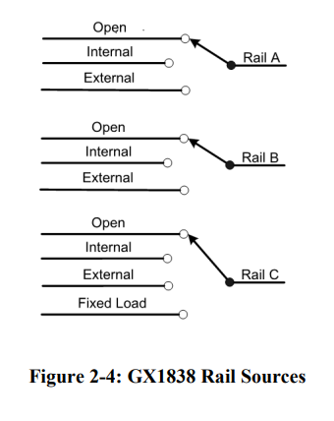

PXI Power Supply
Possible candidate for adjustable power supply
500 mA, up to 32V
Ideal test signal source
Not great for switching large relays

Slide 30
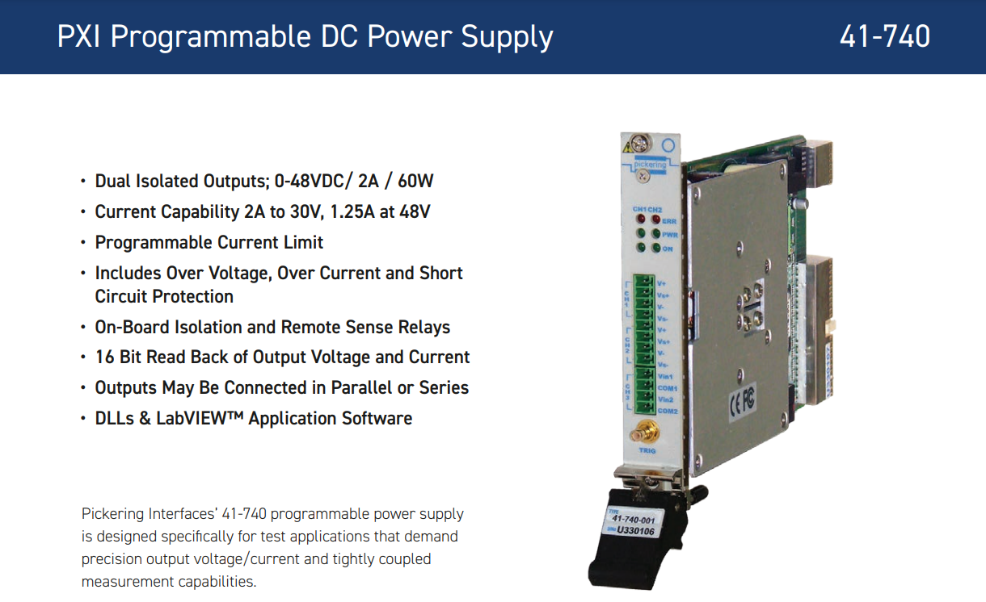
PXI Power Supply
2 Channel
2A, 48V
Great, but could use more channels

Slide 31

PXI SMUs: Precision Sources
Higher-precision sources are called SMU (Source Measure Units)
Typically, low voltages/currents

Slide 32
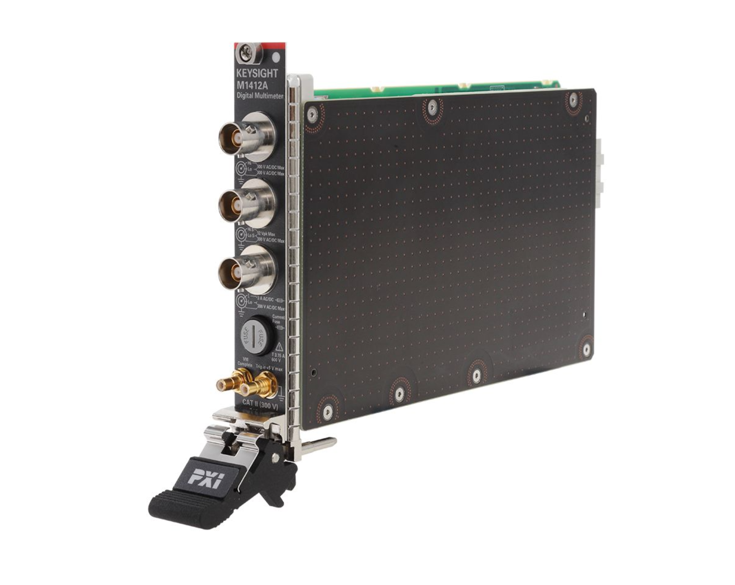
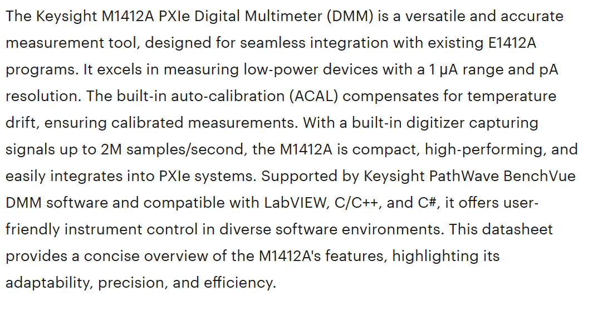
PXI DMM (Digital Multimeters): M1212A – High End
M1412A
7.5 Digit
Costs $8793

Slide 33
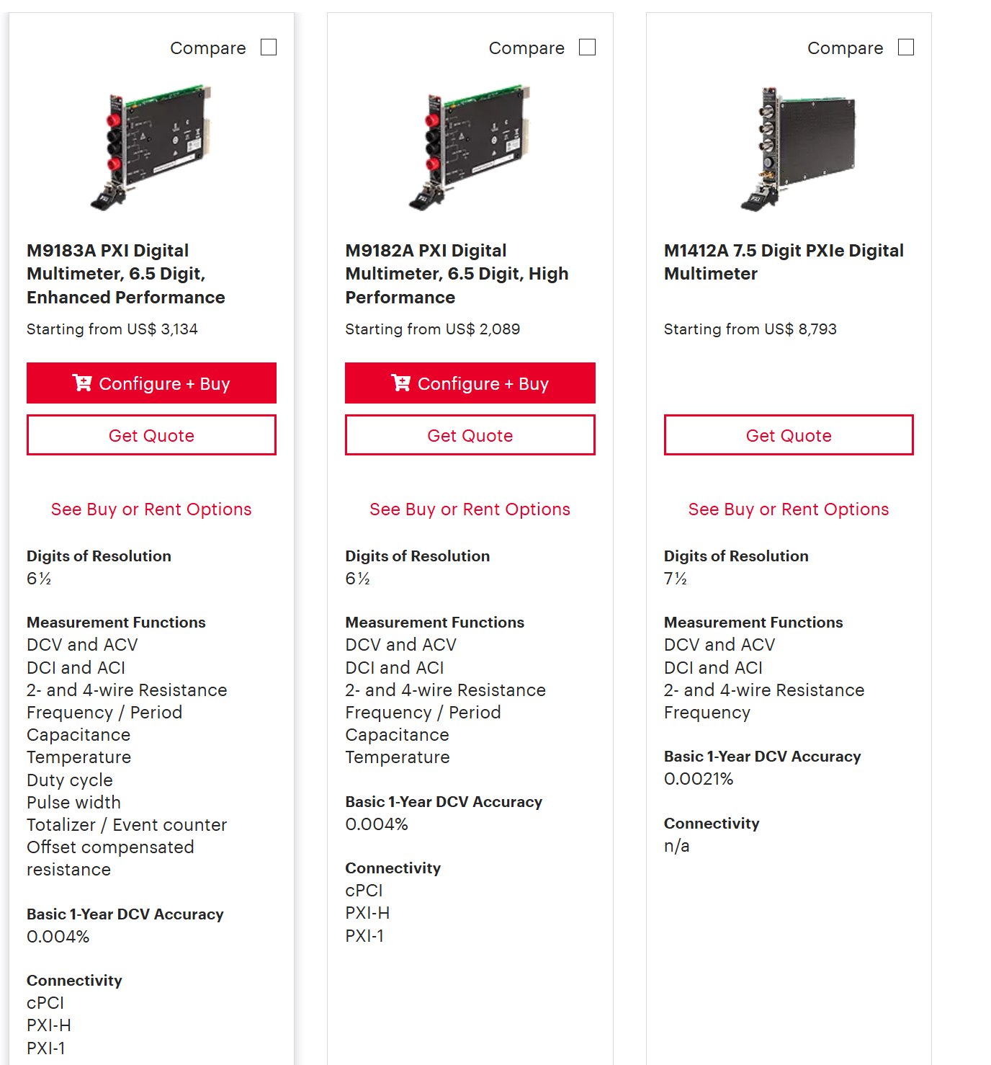
PXI DMM (Digital Multimeters): Other options from Keysight

Slide 34
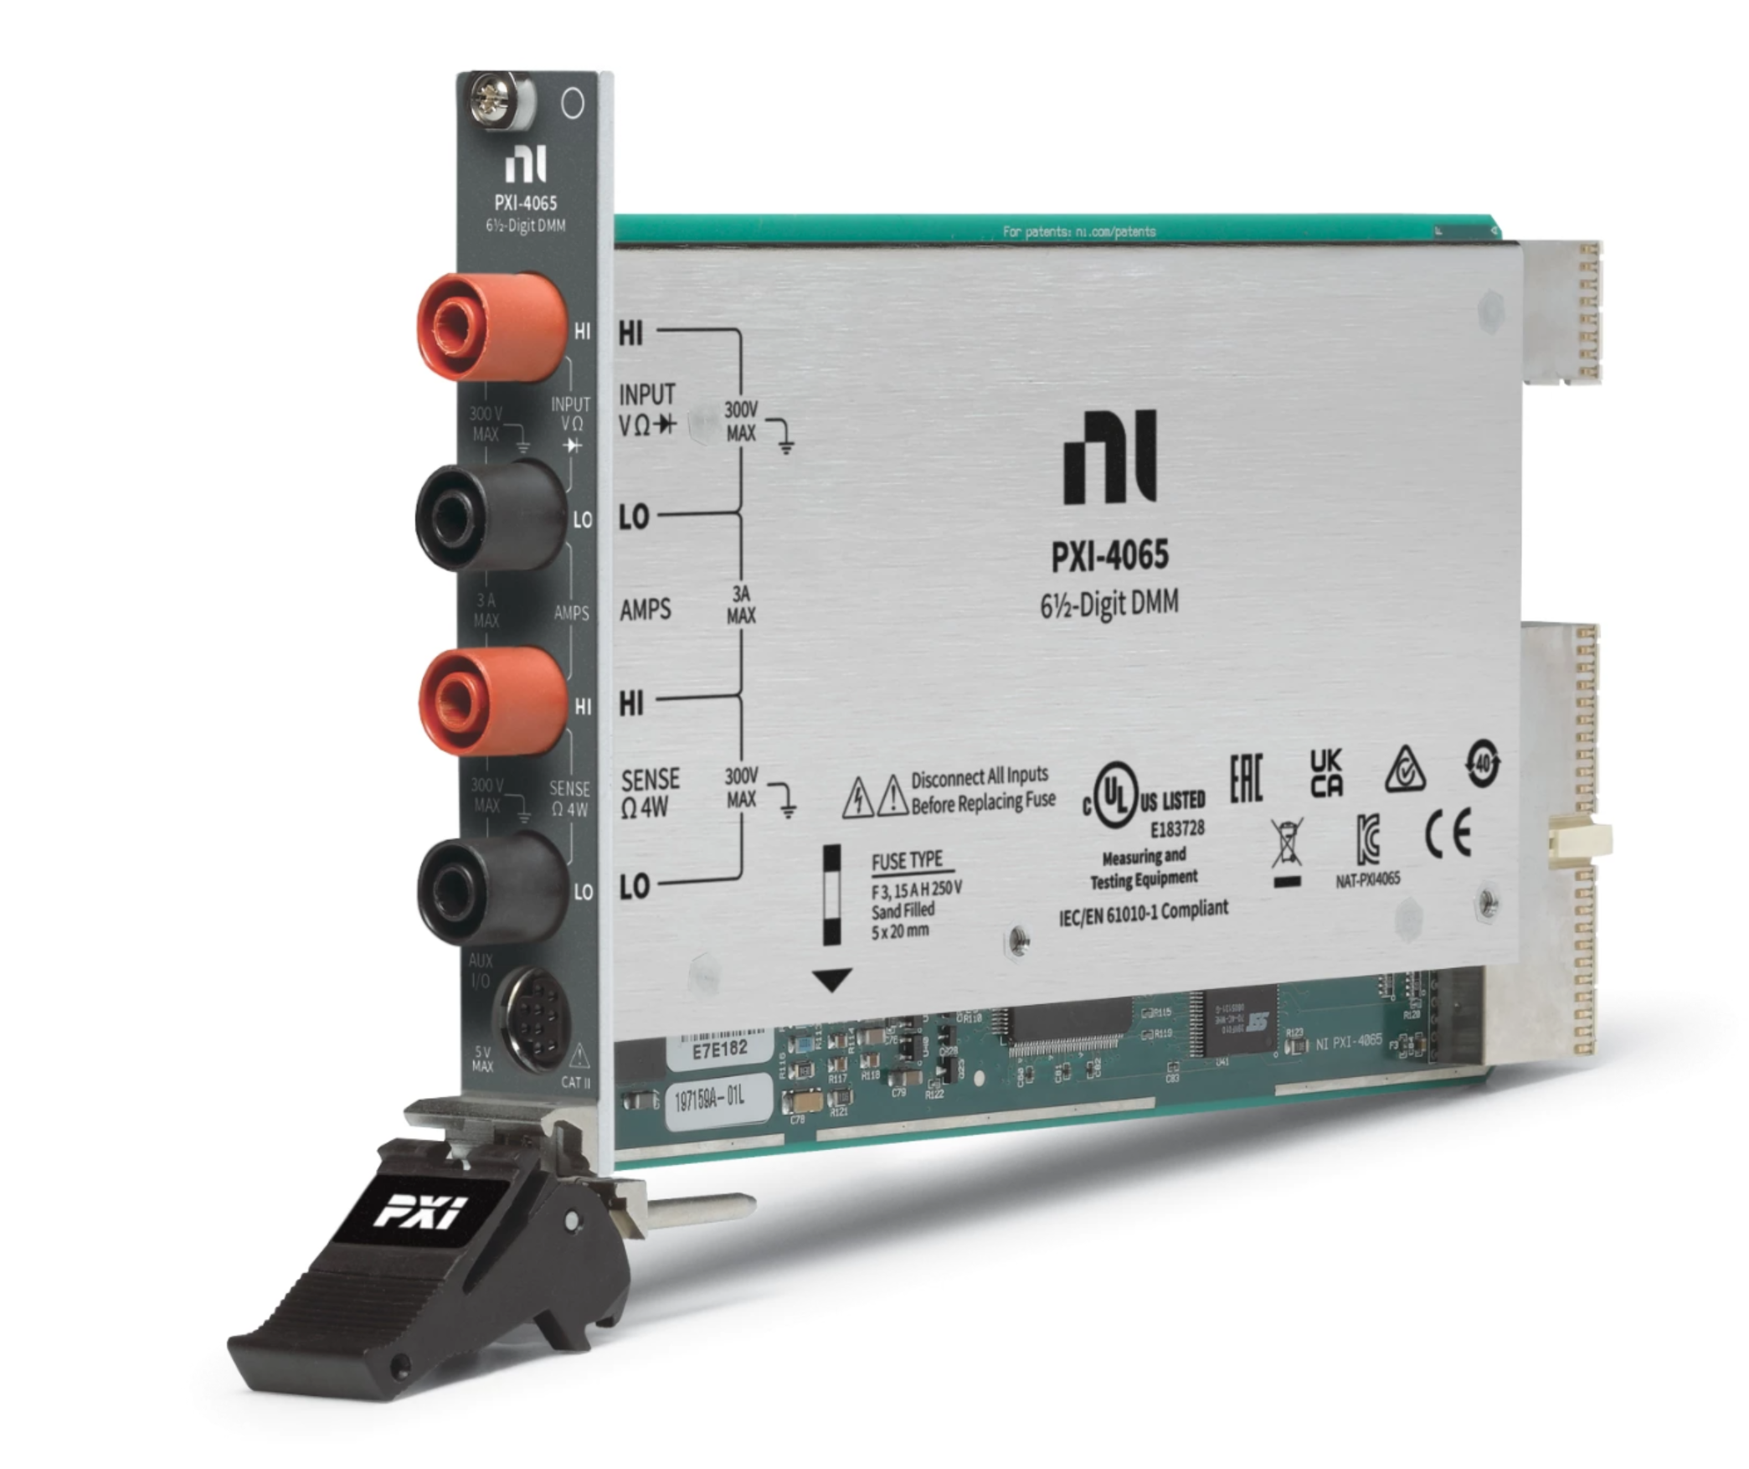
PXI DMM (Digital Multimeters): NI PXI-4065
6.5 Digit
Costs $2085

Slide 35
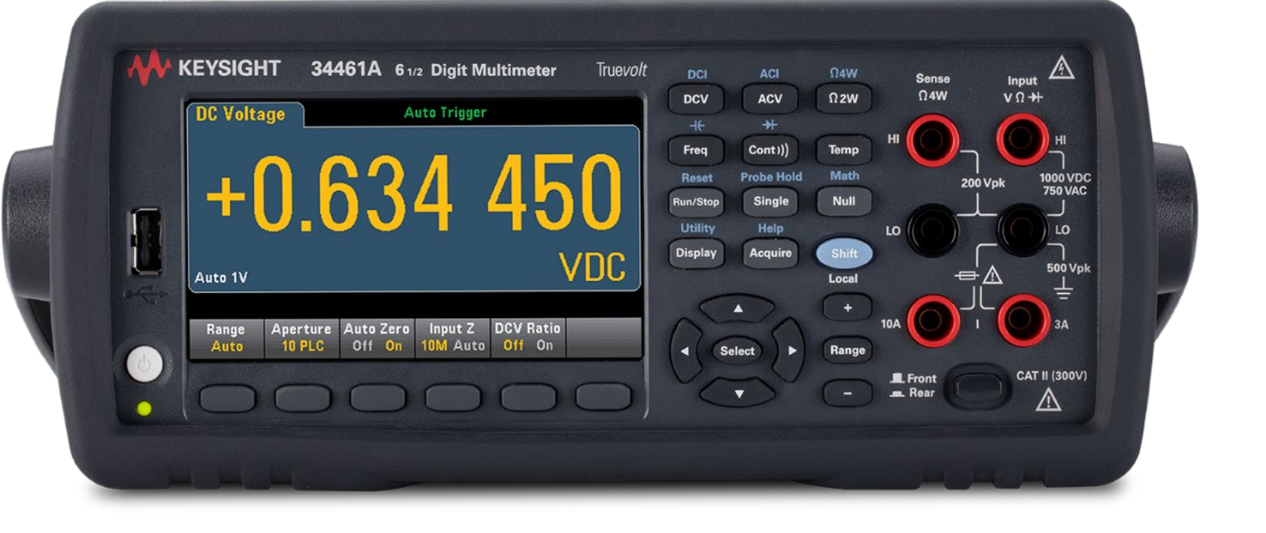
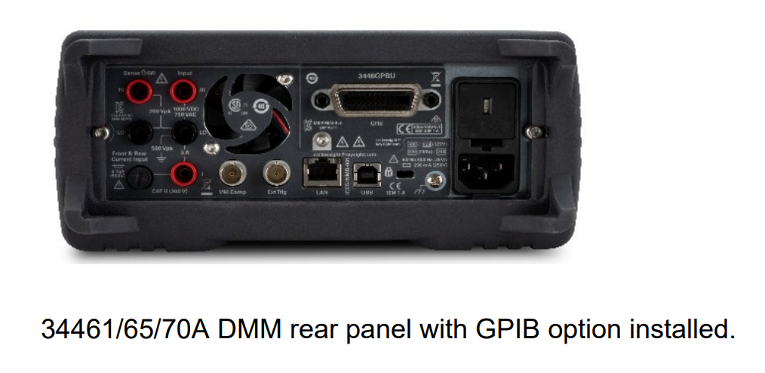
Bench Top DMM (Digital Multimeters): Other options from Keysight
6.5 Digit
Ethernet, USB
Rear probe jacks
Costs $1865

Slide 36
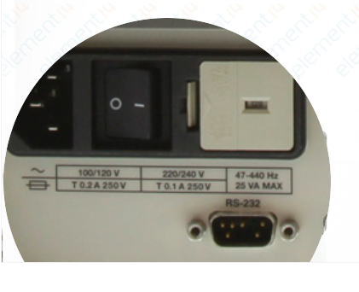
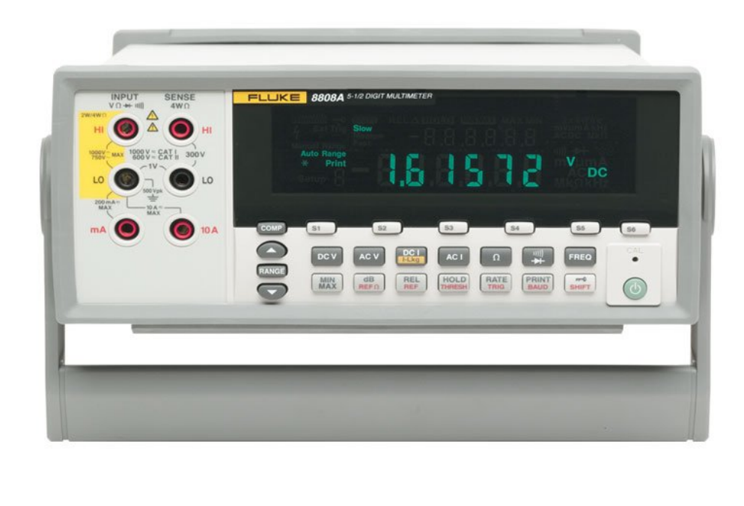
Bench Top DMM (Digital Multimeters): And then there’s Fluke
5.5 Digit
Ethernet, USB Serial
Rear probe jacks
Costs $1360

Slide 37
Structure of a Test Case
A test case is a small program written in Scheme language (Racket)
Constructs a circuits using relay matrix (connect)
Controls test power sources (power-supply-set…, on, off)
Performs measurement using DMM (Digital Multi Meter) (dmm-v, , r)
Evaluates test expression (expect)
Displays an error message if test expression is #f (false).

Slide 38
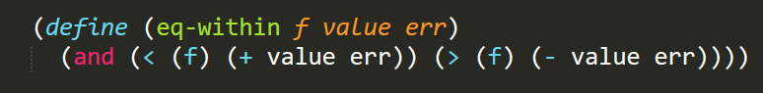
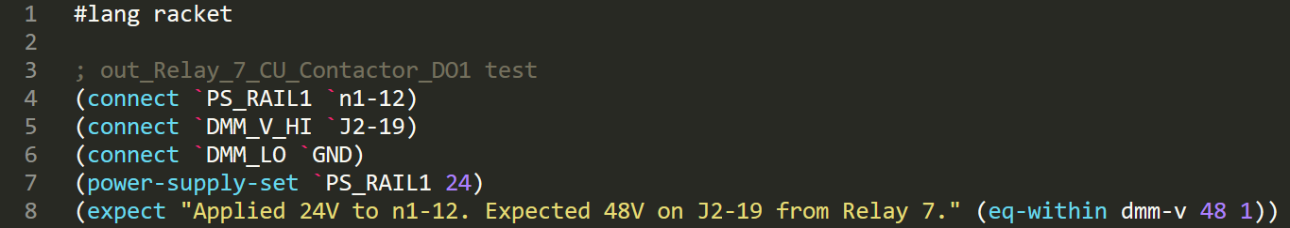
Simplifying Common Patterns
Using Racket you can factor our common code patterns to make tests less repetitive
Functions in Racket are short and sweet
DRY (Do Not Repeat Yourself)

Slide 39
Test Expression Language
Connectivity | Power | Measurement
(connect a b) | (power-supply-set rail v) | (dmm-v)
(disconnect a b) | (power-supply-on rail) | (dmm-i)
(disconnect-all) | (power-supply-off rail) | (dmm-r)
 | (apply-voltage a v) | (voltage a b)
 | (remove-voltage a) | (resistance a b)
 | (apply-ground a)
Defining a common language foundation makes the tests simpler.

Slide 40
Why Test Cases are different from normal software?
Test are written to fail! - If your test can’t fail, you don’t need the test.
Full code of the test must be VISIBLE to the operator!!! - If I don’t understand the test, I can’t fix it.
Tests are written to be debugged. - I want to interact with the tester to reproduce the problem.
Tests are not written to test the tester. - I need to trust the tester to do the right thing.

Slide 41
It may seem beneficial to scan every pin and do pair-wise resistance testing between each test to catch cross-talk. This could be achieved by restructuring many tests to alter a background snapshot of voltage and pairwise resistance across the whole target and then compare measured snapshot to the expected snapshot.
The downside of such setup is slower testing speed, complexity of troubleshooting when issues arise and reduced flexibility. If the test touched 100 relays, how do I know which one caused the problem? The programmers will say “I will write an error message”. But we all know programmers can’t write meaningful error messages and you can’t rely on that to save your life. Far more beneficial is to test what you actually care for and to keep tests simple.

